Slide 1
Nurturing a healthy relationship with technology
February 2021

Slide 2
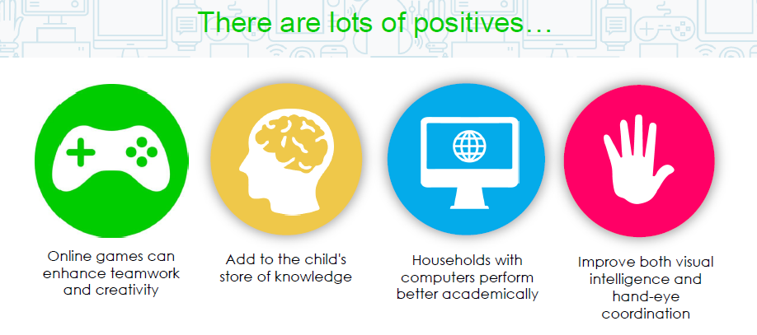
Where would we have been in the last year without technology?

Slide 3
Screen time
Use digital devices together – get involved, have fun, play games and learn together.
Set clear expectations – think about setting some family rules that you agree together. Ask your children to help you set them.
Be informed – most devices offer parental controls so you can control the type of content your child has access to.
Monitor – Be a nosey parent. Apple and Android both have screen time apps to allow you to monitor use.
Establish good habits – encourage a healthy relationship with technology. Avoid use at meal times and the hour before bed.

Slide 4
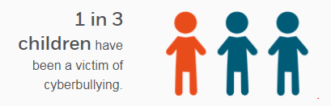
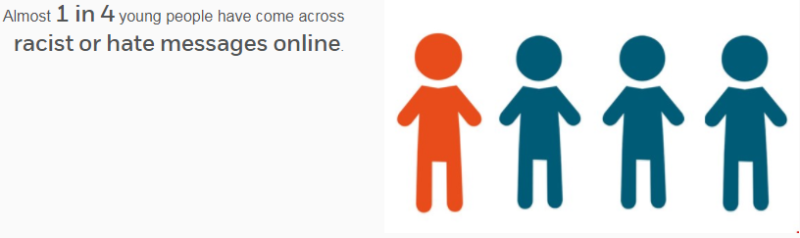

Slide 5
Cyberbullying
Discuss cyberbullying – do not be a bully and do not be a victim. Encourage open discussion if things make them unhappy or uncomfortable.
Save evidence – if you are worried about cyberbullying save the evidence. Screen shots and saving messages.
Report it – report to site administrators, school and if severe contact the local police or children’s services.
Do not reply – never engage and reply to cyberbullies.

Slide 6
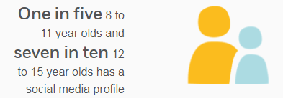
1 in 4 children aged 11 to 16 experienced something upsetting on their social networking profile

Slide 7





Personal information provided on social media
A photo that clearly shows their face
76%
Their last name
83%
3%
Their home address
11%
Their phone number
58%
Their school
London School of Economics and Political Science, 2014

Slide 8
Social Media
Content – talk to children about not posting any pictures, videos or messages that could either embarrass them or get them into trouble.
Contact – talk to children about never posting any personal details (name, address, DOB, school) online. Keep their data safe.
Monitor – ensure you know what social media sites your children are using and what it is they are posting.

Slide 9

Tik Tok
The terms of service state you must be over 13 to use this app.
A social media app that gives users the opportunity to share 60 second short videos with friends, family or the entire world. Videos shared range from funny sketches to lip-sync videos featuring special effects.

Slide 10
Tik Tok
Seeing inappropriate content
Parents have expressed concerns around the inappropriate language of some of the videos posted which may make this less suitable for younger children.
Contact from strangers
Predators seeking to connect with children is another risk that parents have said to their children.

Slide 11
Tik Tok
By default all accounts are public so anyone on the app can see what your child shares. Users can like or react to a video, follow an account or send messages to each other. There is the risk that strangers will be able to directly contact children on the app.
Children may be tempted to take risks to get more of a following or likes on a video so it’s important to talk about what they share and with who.

Slide 12
Tik Tok
Set your account to private
Also, you can set an account to be private so that all videos can only be seen by the creator and no one else on the platform. With a private account, you can approve or deny users and limit incoming messages to followers only.
Please note that even with a private account, your child’s profile photo, username, and bio are still visible to all users on the platform. You can manage who can comment, duet and direct message your child on the app.

Slide 13
Tik Tok
Family Safety Mode:
TikTok’s Family Safety Mode is an in-app feature designed for parents to help keep their kids safe whilst using TikTok. The Family Safety Mode allows the parent to link their TikTok app to up to three kids to manage screen time, turn on restricted mode which prevents kids viewing inappropriate content and lastly, parents can set restrictions on who can engage with children’s comments.

Slide 14

Roblox is an online game creator system where the majority of the content is created by “amateur” game creators. These game makers are able to create and publish games to the community using simple tools. And that means they can try ideas that wouldn’t get funded for a commercial release.

Slide 15
Roblox itself does filter and check the games that are being created both for inappropriate images and profanity. However, games are still allowed that can have horror, murder or bloody themes.

Slide 16
Roblox parental controls
There are parental controls that can be used in the game to ensure Roblox is super safe for younger players. It’s worth checking out the Roblox website for guidance.
First, it is important that you enter the correct date of birth for your child’s account. This will trigger the appropriate safe-chat with a higher level of filtering. Additionally, this means you will get a separate parent login so you can check up on your child’s interactions.

Slide 17
Please see the link at the end of the presentation for more advice.

Slide 18
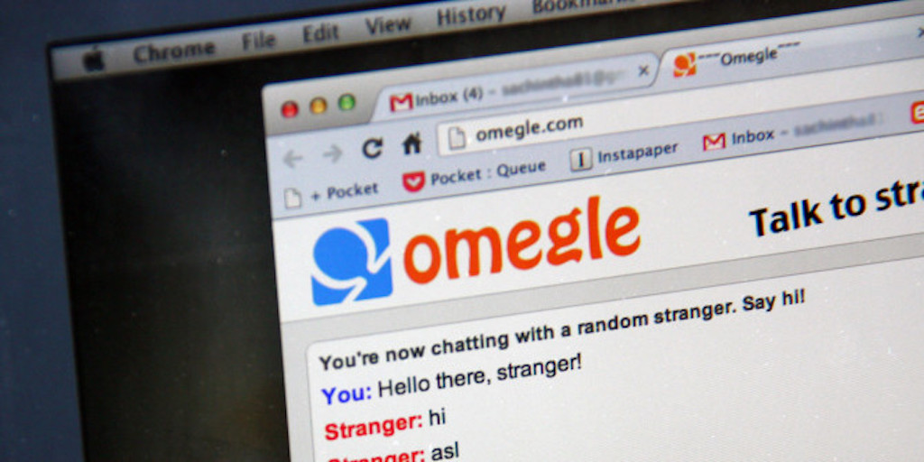
Strongly recommend blocking this site one your parent control filters on your broadband.
BBC News article on Omegle

Slide 19
Prevention and Protection
School
Home
Web-filters and virtual monitoring
Physical monitoring by school staff
Controlled access to technology
Restricted use of mobile technology in school
Monitoring and reporting procedures
Ensure you have parental controls set on your broadband
Link children’s accounts to an adult account to enable monitoring
Be nosey – know what your children are doing and accessing
Think about where your children access the internet

Slide 20
Education
School
Home
Dedicated e-safety lessons using a range of resources
Integrated e-safety as part of computing and PSHE lessons
Termly Key Stage assemblies to raise the profile across the school
KS1 Penguins
Whole school homework
Monitoring digital issues to raise awareness as appropriate
Talk about the safe use of the internet like you would Stranger Danger
Digital Parenting magazine and websites to help you keep up to speed with current issues
Know what to do if there is an issue – children must talk to you and ask for help. Collect information, block and report via CEOP.

Slide 21
Useful websites
Tik Tok What parents need to know
Roblox What parents need to know
www.internetmatters.org
www.thinkuknow.co.uk
www.childnet.com
Where to report concerns
www.ceop.police.uk

