Slide 1
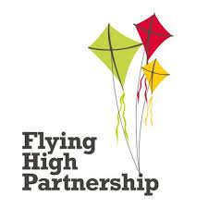
Flying high trust awards
By lily vaed

Slide 2
What is the flying high trust?
The Flying High Trust is a group of primary schools in the East Midlands that places include children for every decision they make. They aim for our schools to become the best it can be through collaboration, support and responsibility.

Slide 3
VIDEO
This is what it is like at the awards evening.

Slide 4
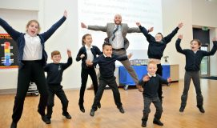
What is it about
The flying high trust is about following the values that we have such as aspiration, confidence and fun.

Slide 5
You get to vote !
Later in the year , we have the flying high trust awards where children get voted by others for showing the values consistently and for being a great role model . You can vote for adults too!

Slide 6
What happens if you get voted
If you get voted you get to go to the flying high trust awards evening ,which happens once every year as you might know.

Slide 7
Thank you

