Slide 1
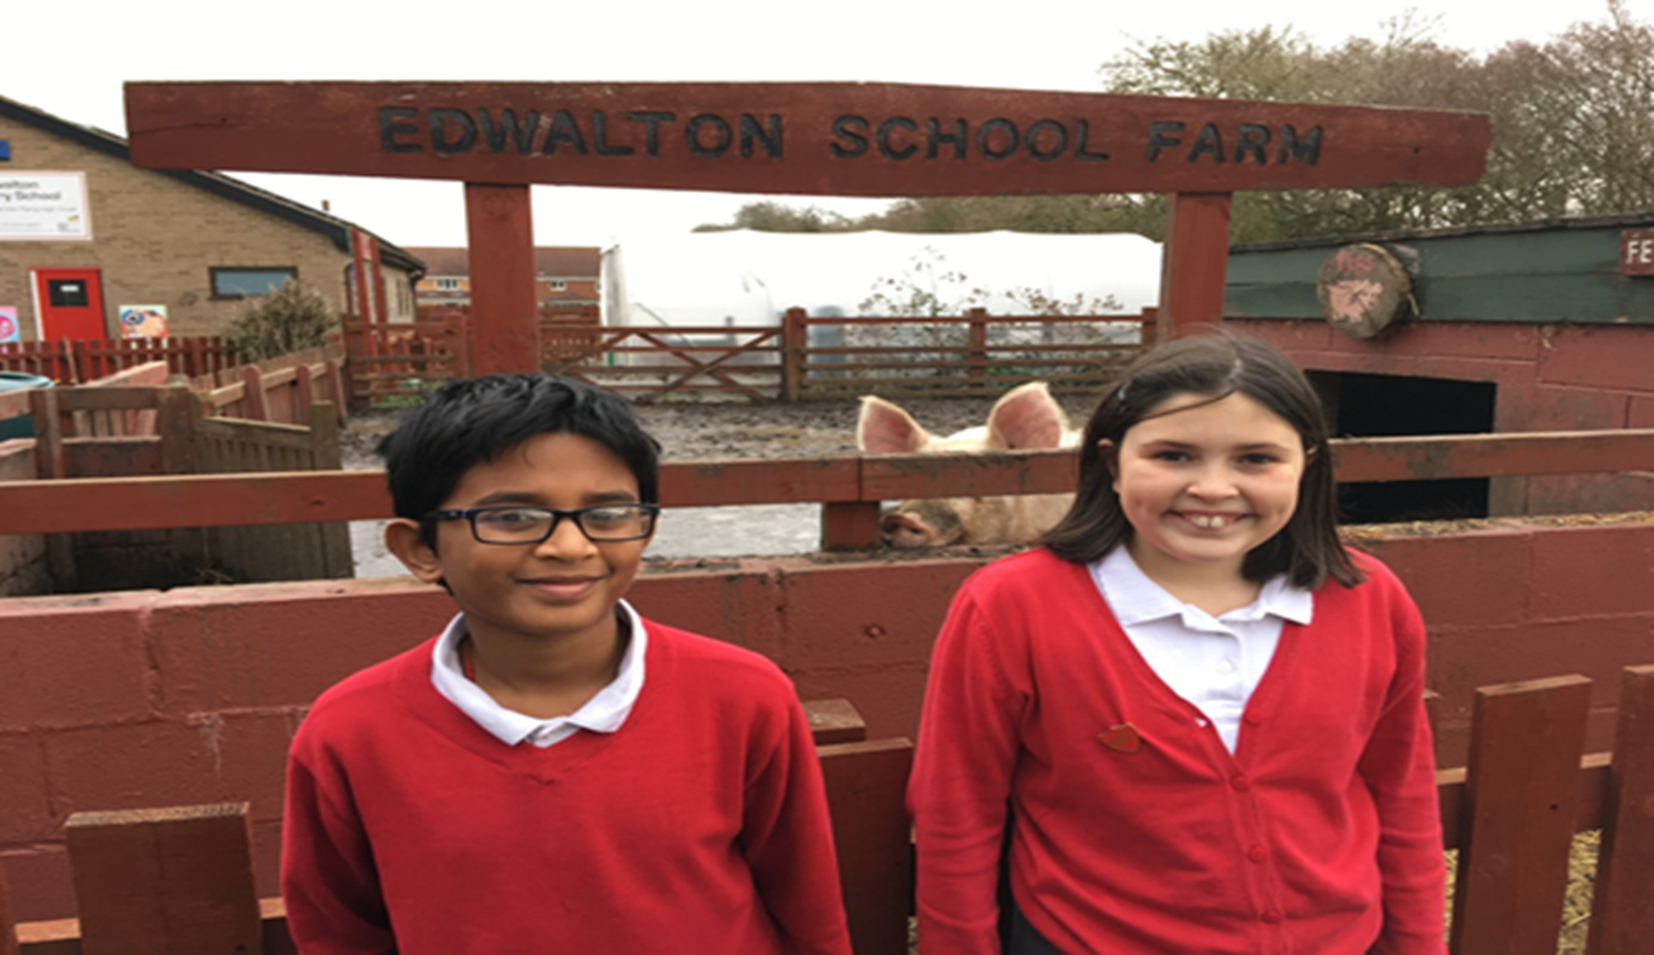
health and safety 8.2.19.
By Lily and Vaed

Slide 3
The scooters
The scooter holder has now been built so foundation have their scooters in it.

Slide 4
The bridge is now fixed
The bridge in the new adventure playground has now been fixed so children can play on it again.

Slide 5
The grass
The grass on the field was very muddy and in the Summer it had holes in it but it has now grown back and a bit better than before for the Summer.

Slide 6
The flowerbed
The muddy part , which is near foundation has been turned into a flowerbed with fresh soil in it .

Slide 7
The toilet in cherry has been fixed
The toilet ln cherry has been replaced with a new one which has got the seat on.

Slide 8
The plank on the bench
The plank on the bench has been fixed so it is now safe to sit on.

