Slide 1
School Council
Health and Safety Check (16.10.18.)
By Lily and Vaed

Slide 2
Adventure playground
We are having a new adventure playground

Slide 3
The water butt
The water butt lid is loose

Slide 4
The bench plank
One of the planks on the bench need replacing.

Slide 5
The grass on the field
There are chunks of grass that have been dried up.

Slide 6
Gardens
There is a flowerbed going here soon.

Slide 7
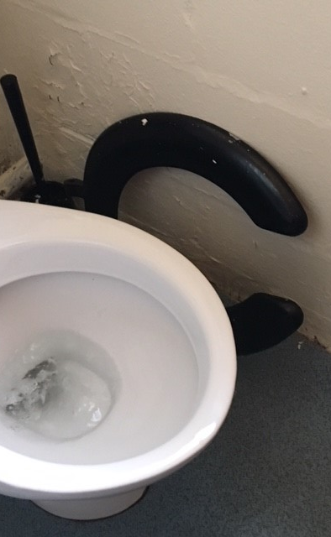
Boys’ toilet seat
The boys’ toilet seat in Cherry has come off.

Slide 8
Scooter area for Foundation
We are having a new scooter parking area for Foundation.

