Slide 1
School Council
Health and Safety check
(14.10.19)
By Hana and Zane
Year 6 , Beech

Slide 2
Rabbit Island
A hut in Rabbit Island is broken.

Slide 3
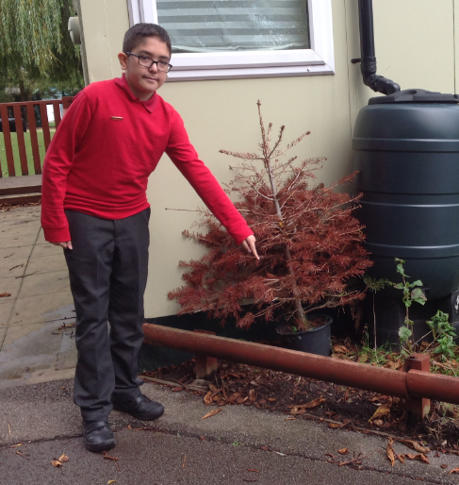
Playground Fence
The fence outside the Y5 classrooms is broken and wobbly.

Slide 4
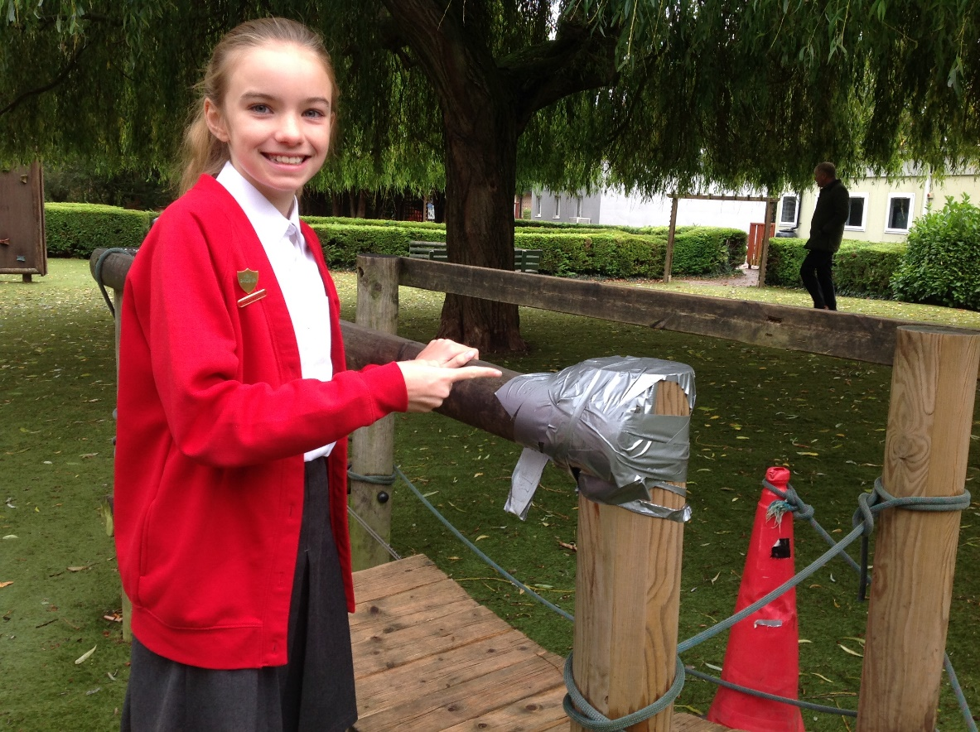
The bridge
The corner of the bridge needs fixing.

Slide 5
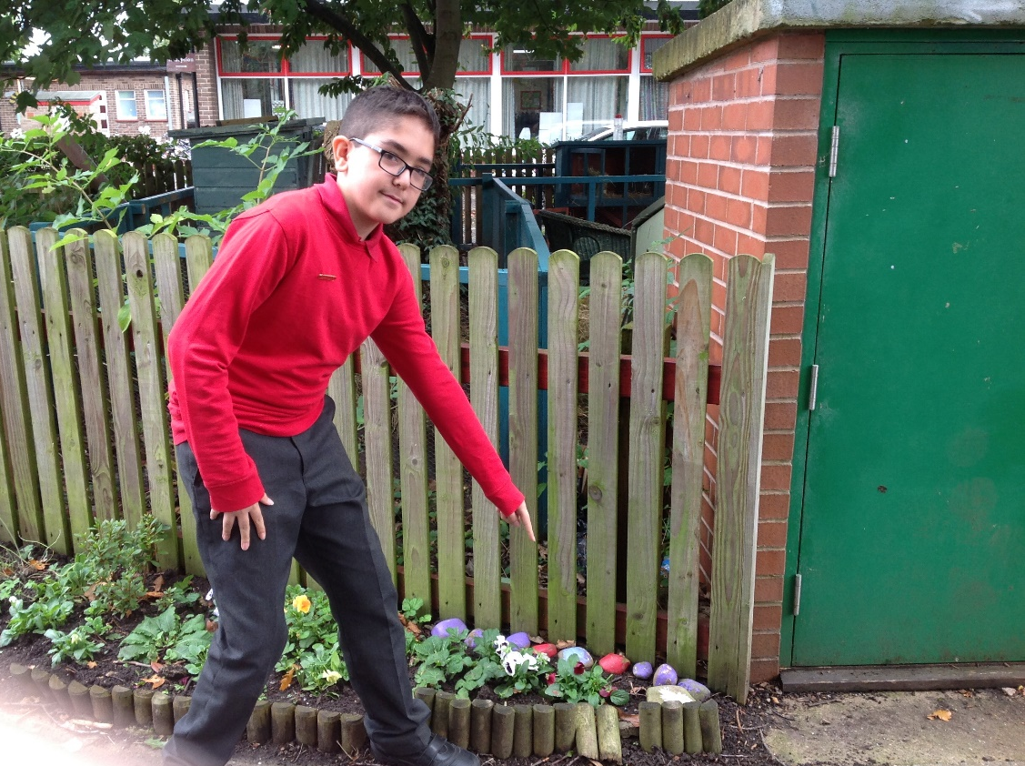
The garden border
The small garden border has collapsed in some places.

Slide 6
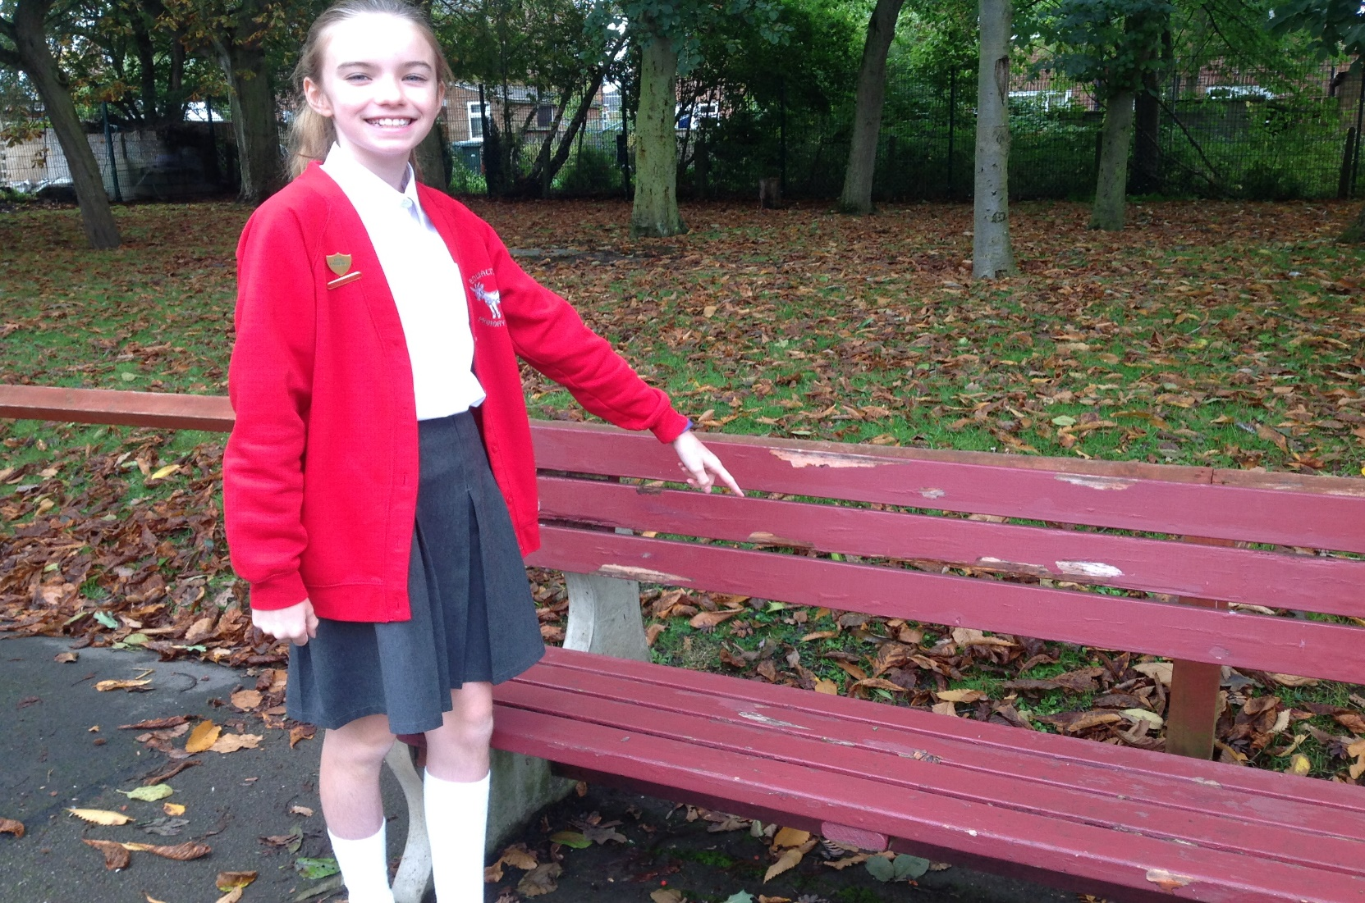
The bench
The bench near the bike rack is damaged.

Slide 7
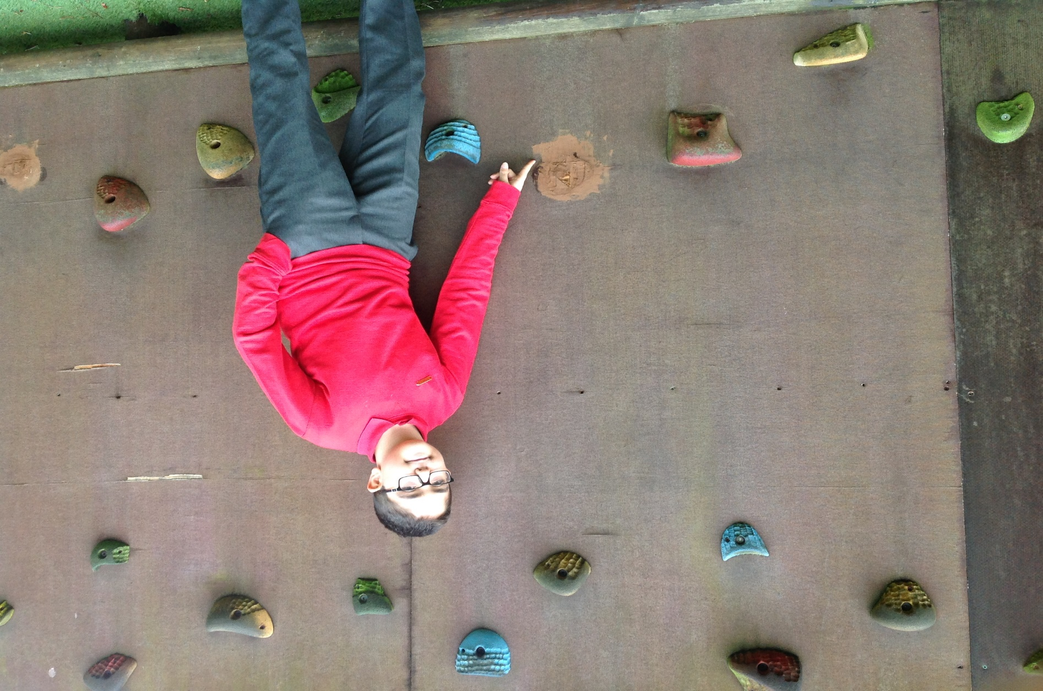
The climbing wall
The climbing wall has missing parts.

Slide 8
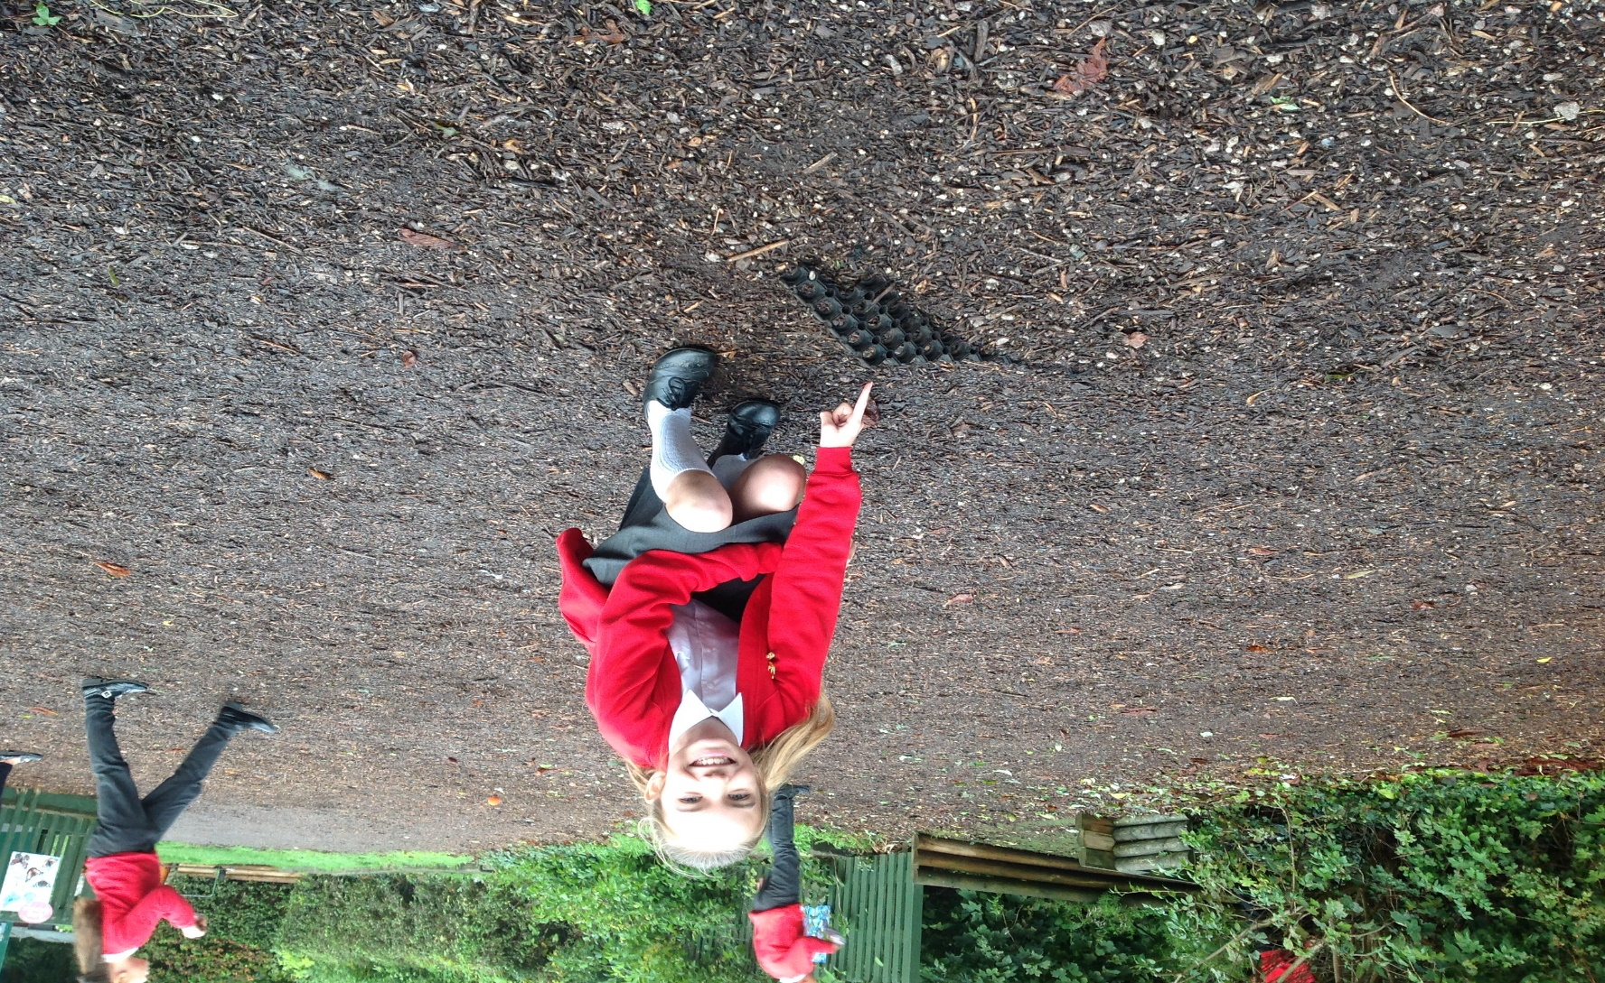
The bark outside Spruce class
A piece of Astro is sticking out of the ground, which is causing a trip hazard.

Slide 9
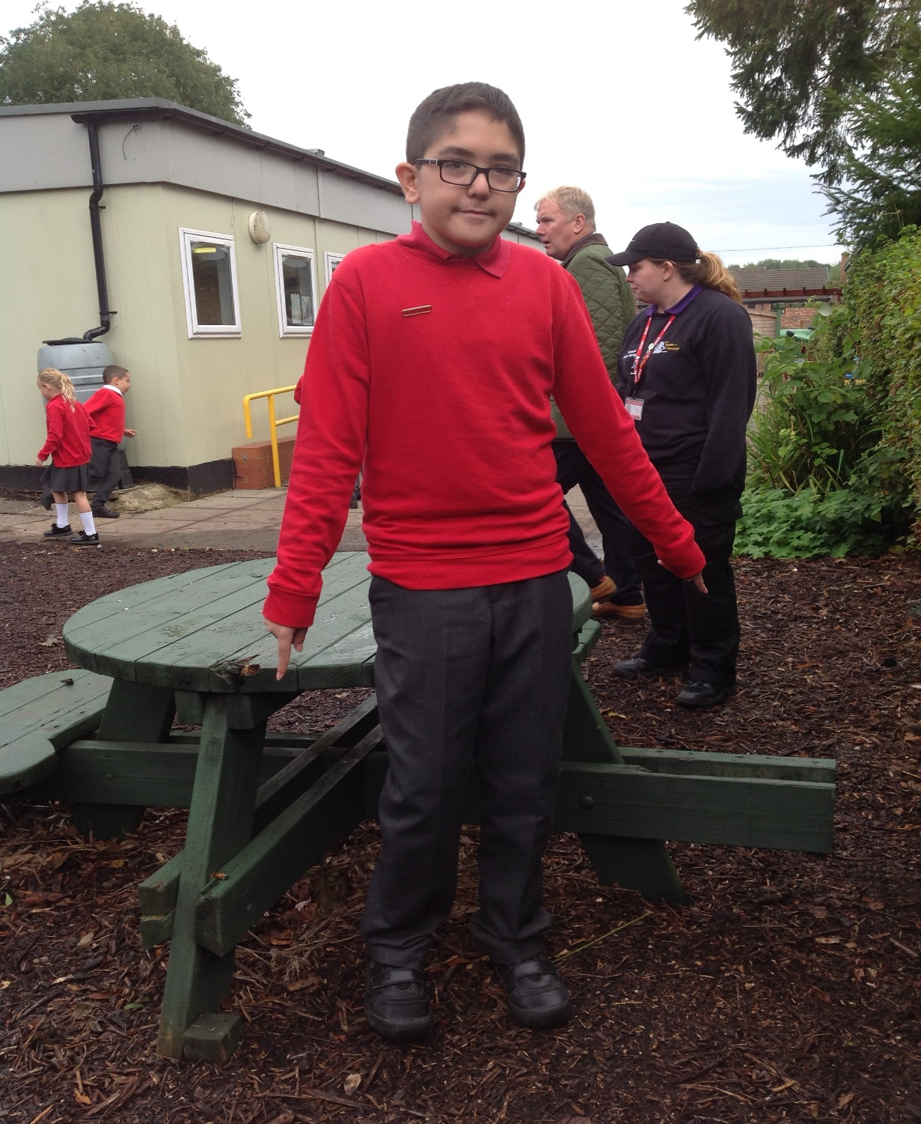
The table
The seating next to Spruce class is missing.

Slide 10
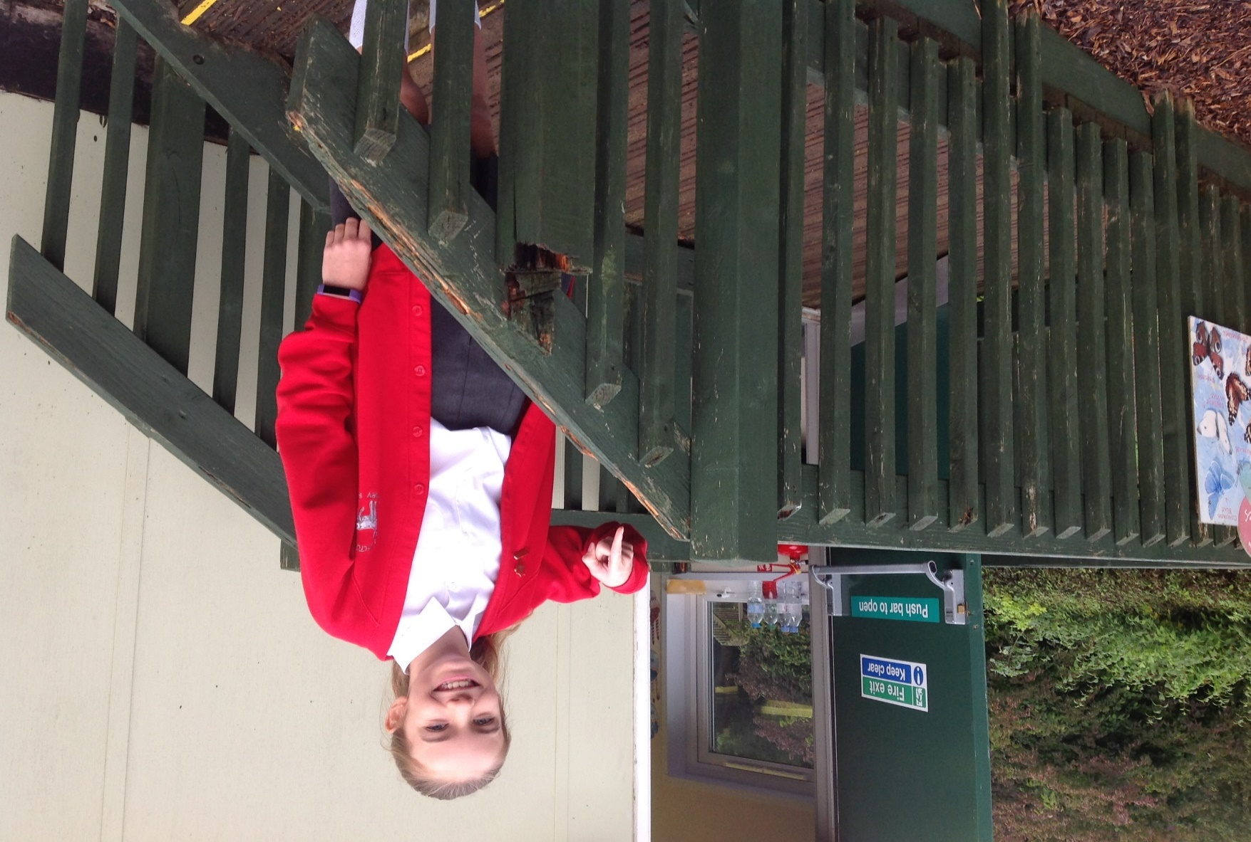
The Spruce Fire Exit
The fire exit for Spruce class is unstable and broken

