Slide 1
Health And Safety Check 2 6.2.18.
School Parliament Members:
Luke & Kate

Slide 2
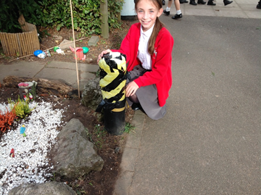
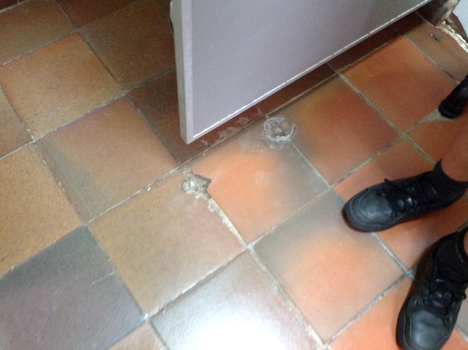
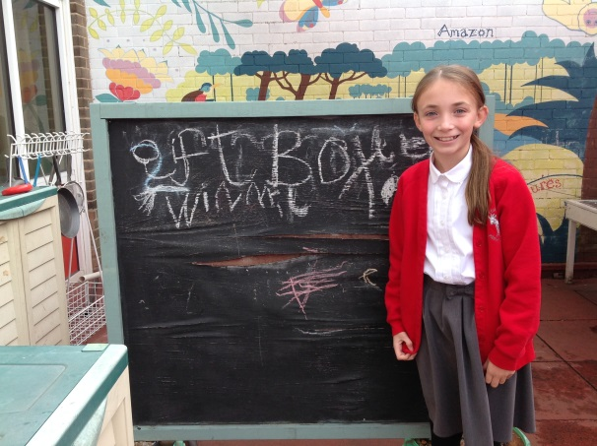
What has been fixed
The wood that holds up the bench.
The chalk board in the Year 1 play area.
The ground in the boys toilets, Willow class Y6.
The carpet has been fixed, Beech Class Y6.

Slide 3
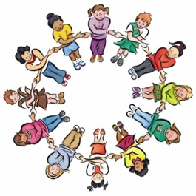
Other Things We’ve Found
- There is a giant puddle on the playground. (Need new flooring)
- Big mud patch on a slope.
Big tripping hazard, Beech Y6.

Slide 4
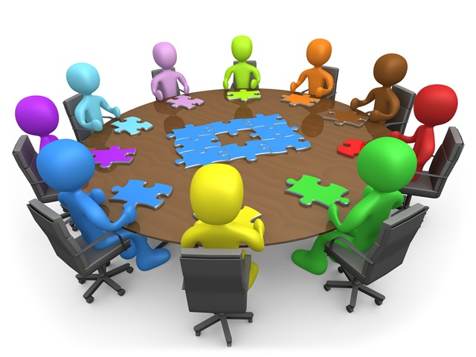
By Kate & Luke ☺

